Slide 1


Ganesh Gopi Naveen Ram
Sakthi Sudharshan Swaroop Uday
DK12
Notes:
Image: DK12.jpg

Slide 2
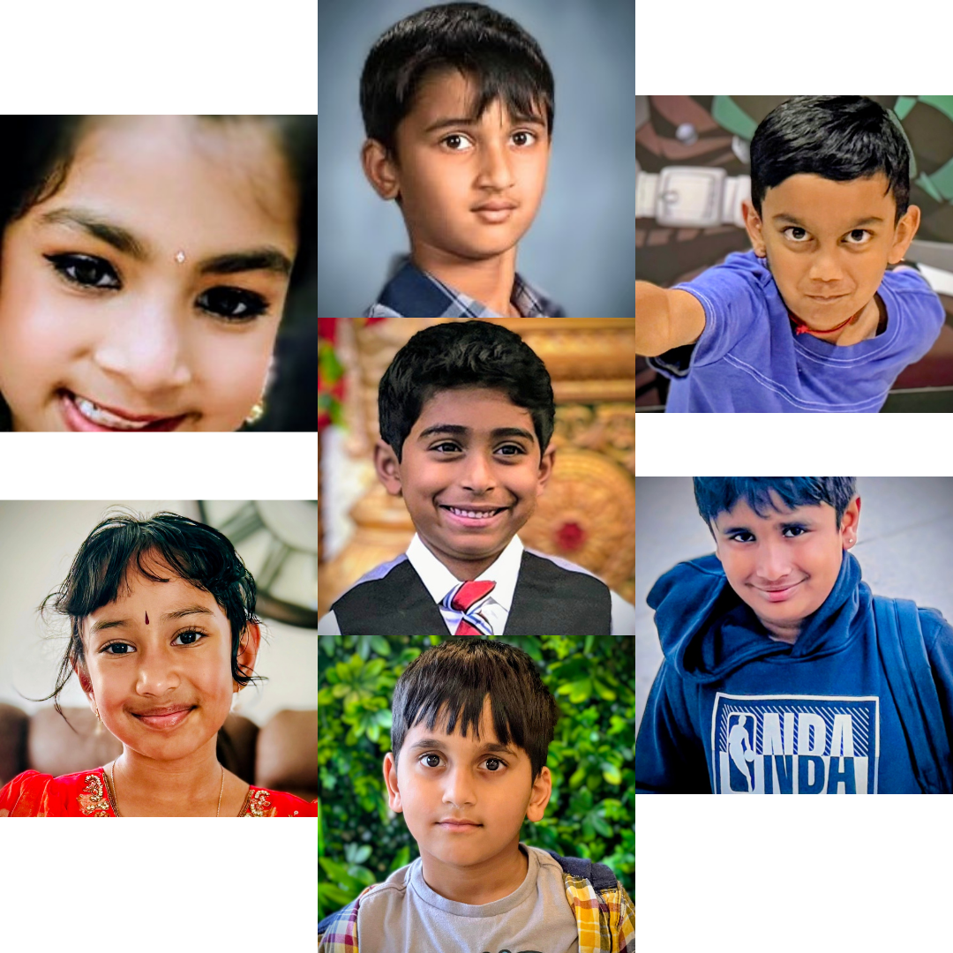
Diya Velamuri Lavnish Rhea Manikandan Rutvik Ram Vankam
Tanush Vinodh Tathvish Vinodh Vishnudev Dhinuraju
DK20
Notes:
Image: DK20.jpg

Slide 3
Insert Photo
GCTS Neram
Notes:
Image not found. ImageFile=''. Also tried from SlideName='GCTS Neram'. Searched in: ['/Users/AB74296/Downloads/DK PPT', '/Users/AB74296/Downloads/DK PPT/images', '/Users/AB74296/Downloads/DK PPT/imgs', '/Users/AB74296/Downloads/DK PPT/photos']

Slide 4
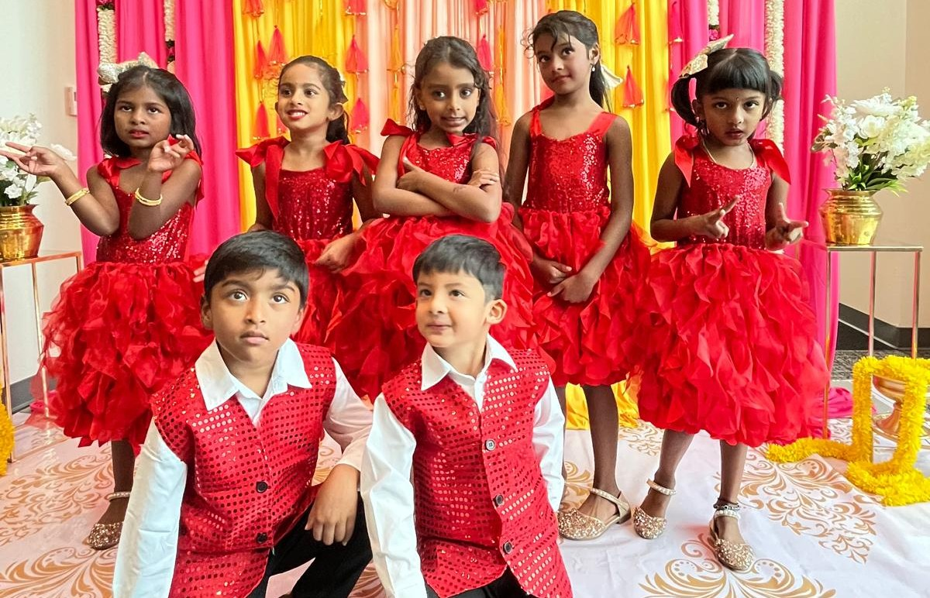
Aadhya Arun Devarsh Jhanvi Mena Liana Pradeep
Rakshaa Sivanandha Rihaan Ganesh Sudhiksha Arunkumar Uthra Rathnakumar
DK11
Notes:
Image: DK11.jpeg

Slide 5
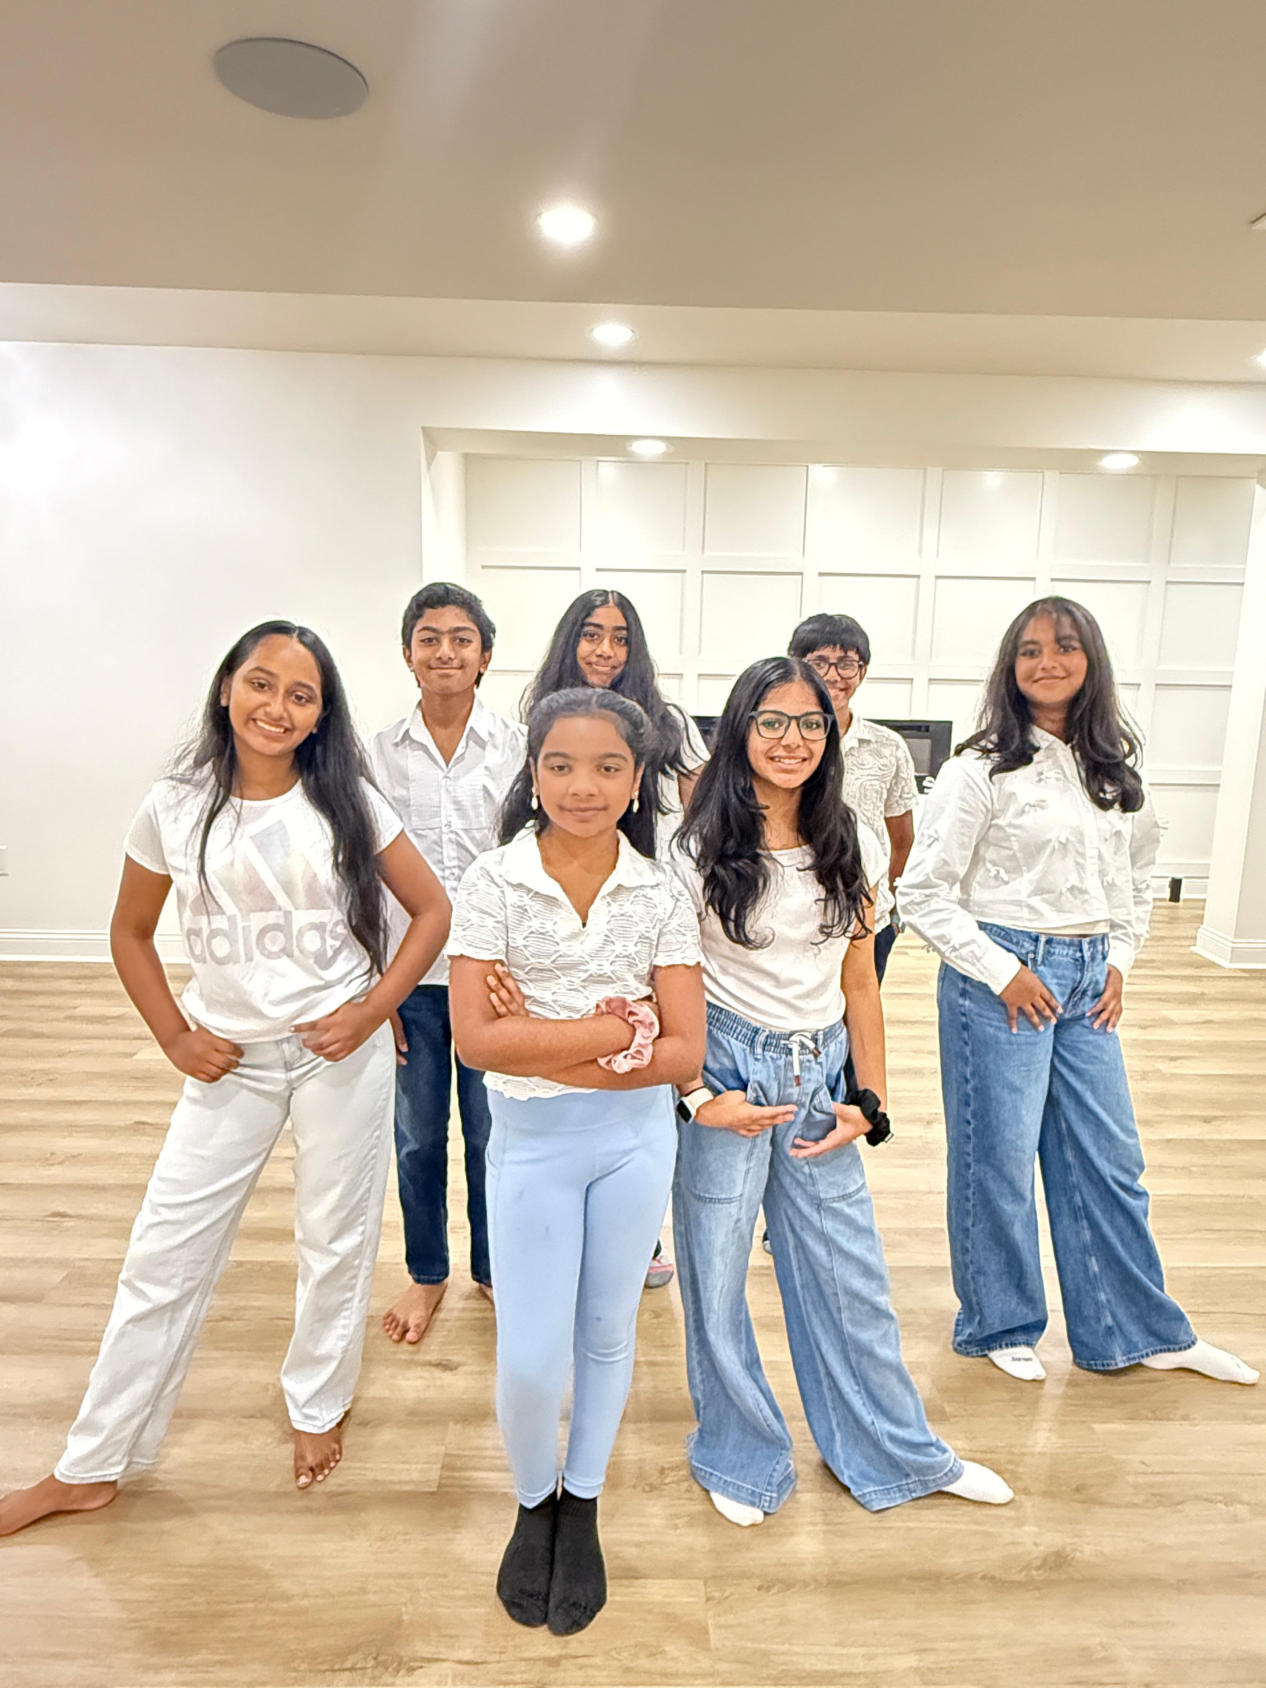
Advith Dinesh Diya Kirubakaran Iniya Senthilkumar Jaanvi Venkatesh
Jyotsna Karthikeyan Veya Vetriilaval Vikram Mohan
DK30
Notes:
Image not found. ImageFile=''. Also tried from SlideName='DK30'. Searched in: ['/Users/AB74296/Downloads/DK PPT', '/Users/AB74296/Downloads/DK PPT/images', '/Users/AB74296/Downloads/DK PPT/imgs', '/Users/AB74296/Downloads/DK PPT/photos']

Slide 6
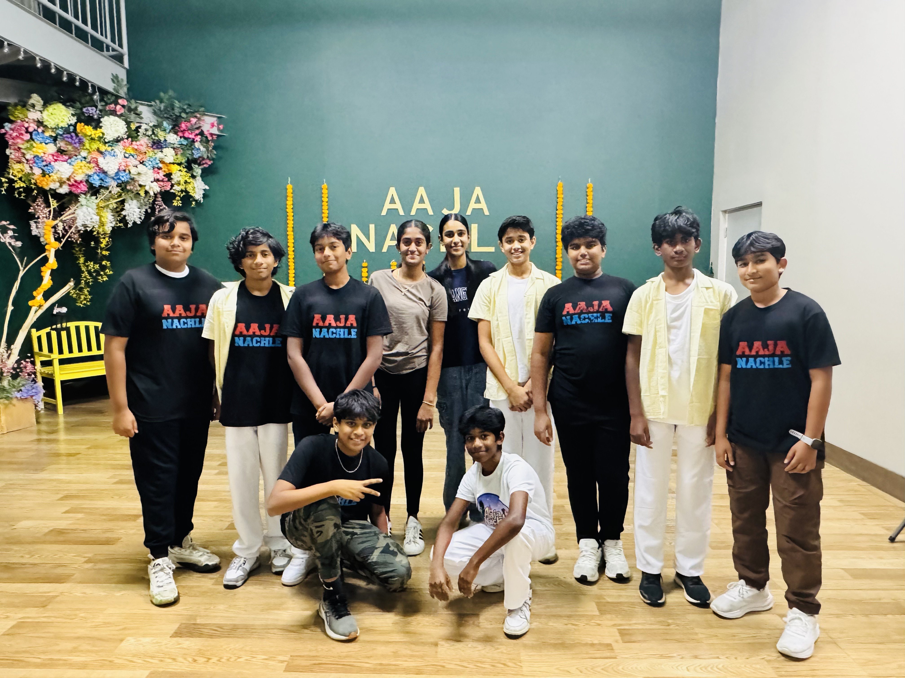
Anirudh Boreddy Arjun Ramagiri Arnav Keskar Atharv Vaidya Chaarvi Iyengar Harsha Prathiwada Karthik Challa
Nimesh Varun Rajesh Praneeth Sai Chemarthi Rishaan Giri Rishik Reddy Jillella Ronith Sarpoor Kamalesh Sanjith Sivan
DK16
Notes:
Image: DK16.jpg (converted)

Slide 7
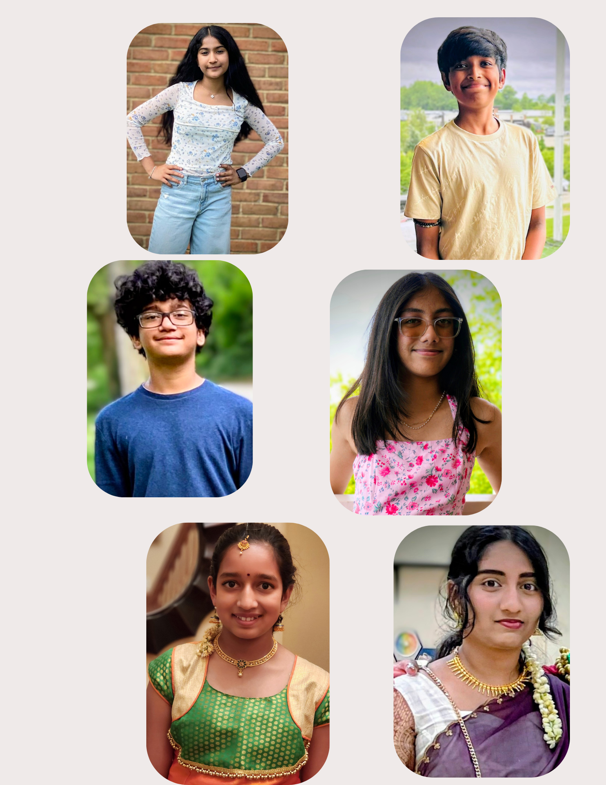
Aarohi Reddy Angad Renjith Pillai Dhinuraju Vijayan Divya Dilip Kanishka Sikha - Shika
Nithya Vanapalli Santhoshini Dhinu Shashanth Uppara Shubham Mahajan Suchit Chinthireddy
DK33
Notes:
Image: DK33.jpg

Slide 8
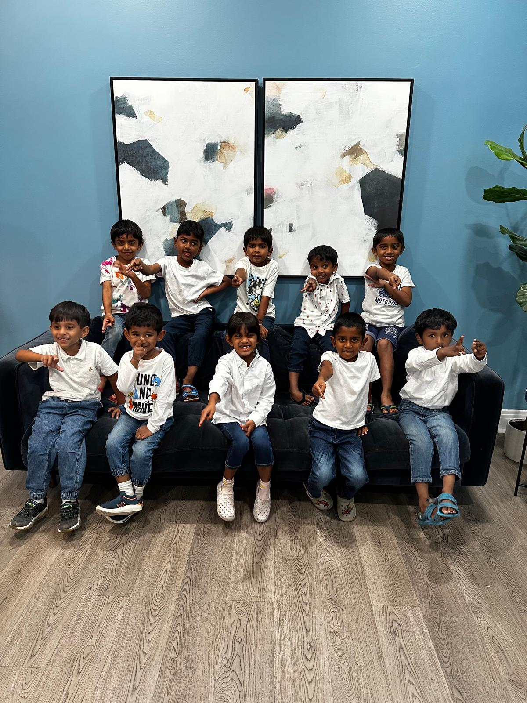
Advik Saravanan Amar Cheekur Srikanth Aneer Raju Krishiv Muthukumar Muhammad Muhsin Nazeeb
Pranika Uthararaj Sai Litheswara Shanwik Guruprasad Vishakan Vinothkumar Vishwajith Dileep
DK18
Notes:
Image: DK18.jpeg

Slide 9
Insert Photo
GCTS Sports
Notes:
Image not found. ImageFile=''. Also tried from SlideName='GCTS Sports'. Searched in: ['/Users/AB74296/Downloads/DK PPT', '/Users/AB74296/Downloads/DK PPT/images', '/Users/AB74296/Downloads/DK PPT/imgs', '/Users/AB74296/Downloads/DK PPT/photos']

Slide 10
Insert Photo
Vote of Thanks
Notes:
Image not found. ImageFile=''. Also tried from SlideName='Vote of Thanks'. Searched in: ['/Users/AB74296/Downloads/DK PPT', '/Users/AB74296/Downloads/DK PPT/images', '/Users/AB74296/Downloads/DK PPT/imgs', '/Users/AB74296/Downloads/DK PPT/photos']

Slide 11
Insert Photo
National Anthem
Notes:
Image not found. ImageFile=''. Also tried from SlideName='National Anthem'. Searched in: ['/Users/AB74296/Downloads/DK PPT', '/Users/AB74296/Downloads/DK PPT/images', '/Users/AB74296/Downloads/DK PPT/imgs', '/Users/AB74296/Downloads/DK PPT/photos']

